Slide 1
GJ Tube Detection Application for SickKids Hospital
Version 1.0.0
Dr. Bairbre, Simal Goman, Prem Patel, Wayne Lee, David DeVries

Slide 2
Overview of Presentation
Workflow and UI Overview
Tube Segmentation Algorithm
Room for Further Development
Questions

Slide 3
Workflow/UI Overview
Load Image(s)
Select ROI/adjust contrast
Select waypoints
Perform GJ Tube segmentation

Slide 4
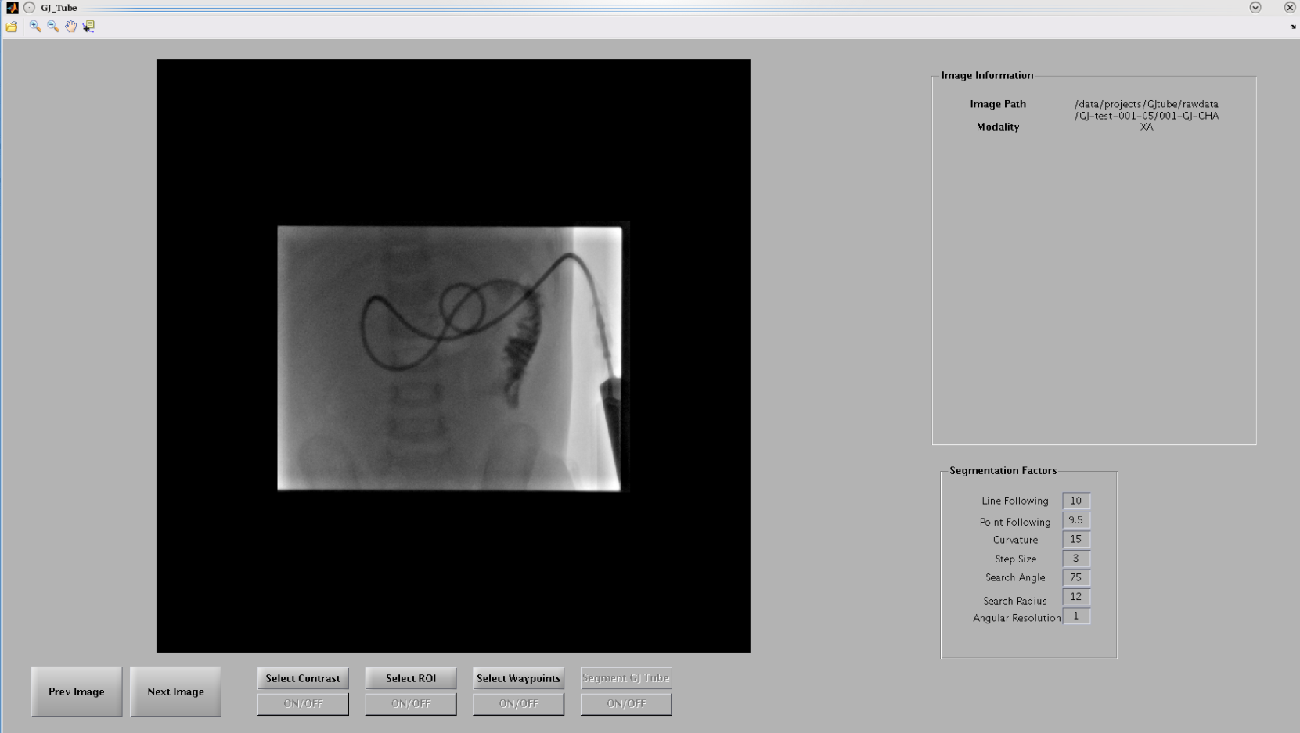
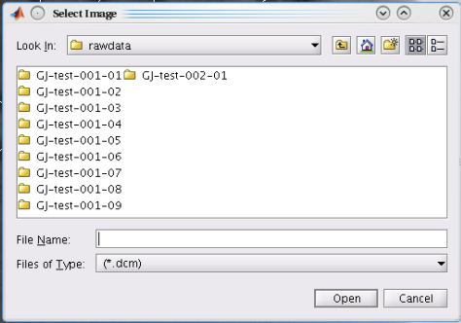
Loading Image(s)
Standard/familiar interface
Extracts DICOM header information
Can load multiple images (time/angle)

Slide 5
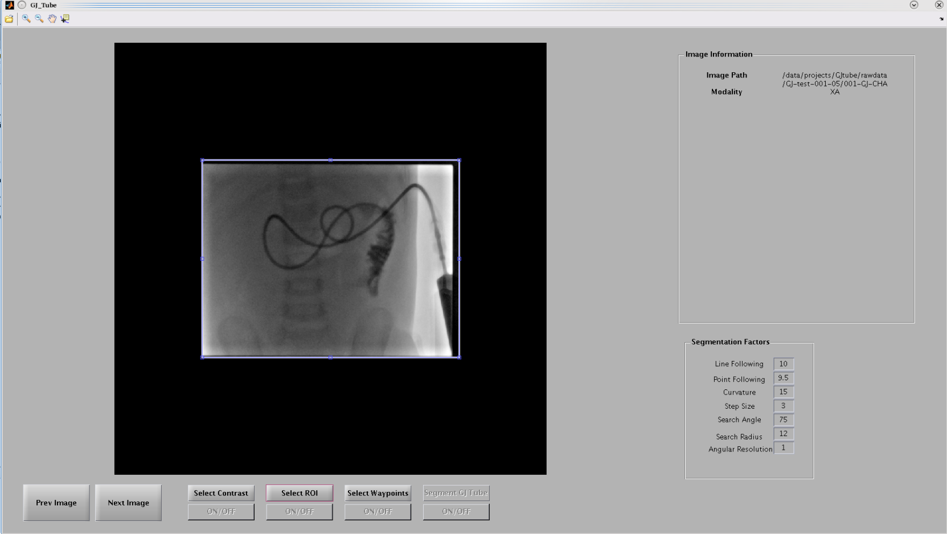
Select ROI
Selects smaller area
Automatically suggests area based on edges

Slide 6
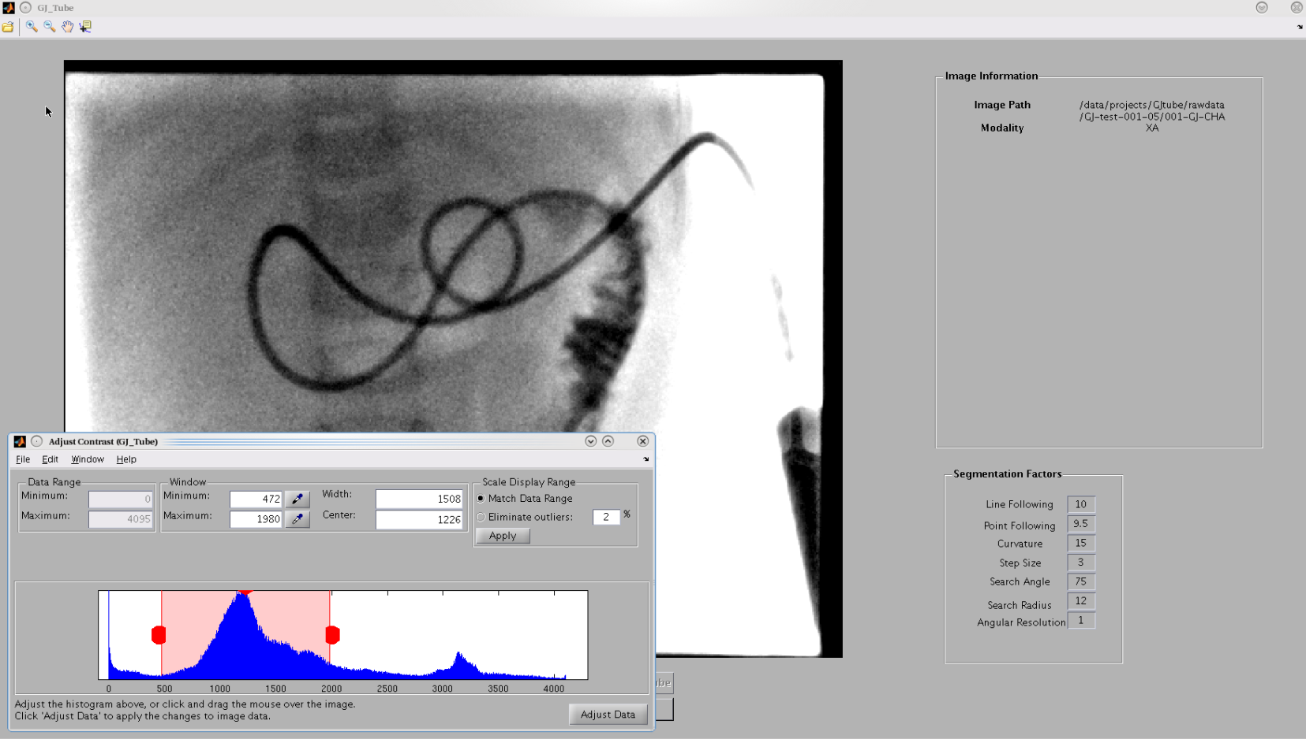
Contrast
Uses built-in MATLAB contrast UI
TODO: Switch to UI that is more familiar

Slide 7
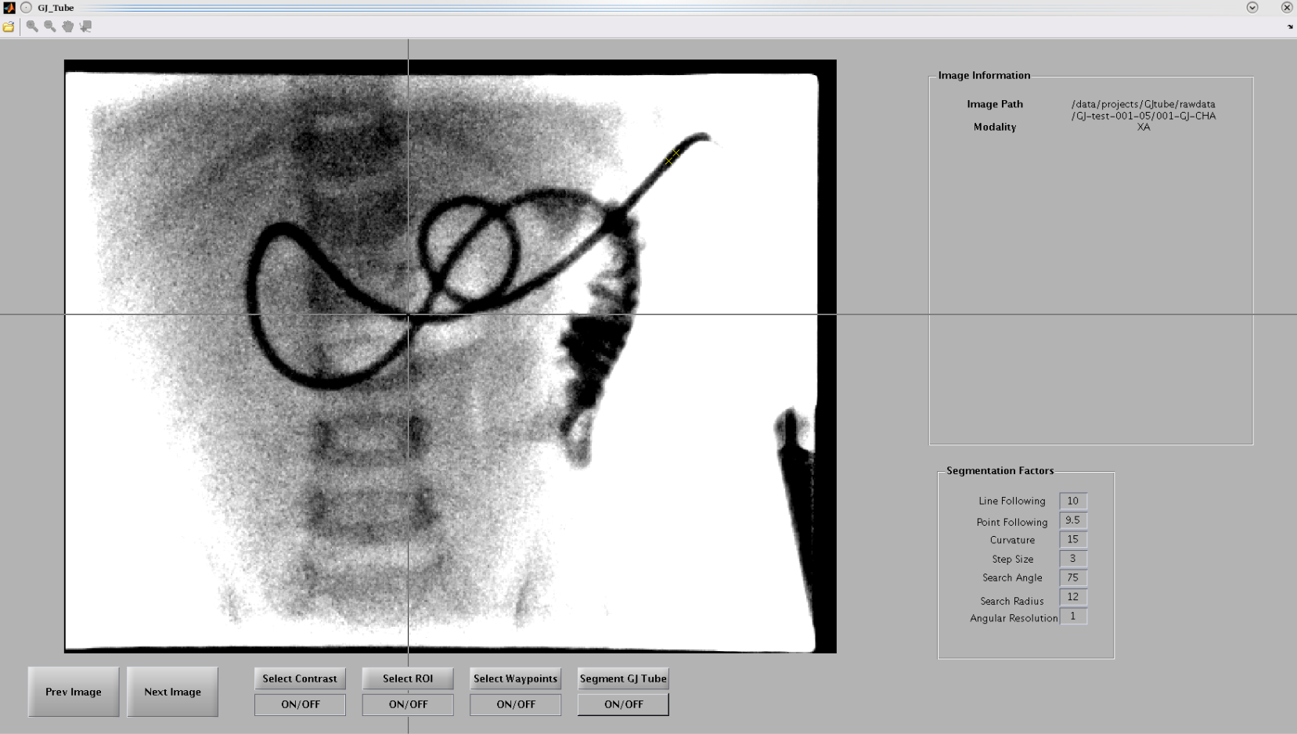
Waypoint Selection
User defines start/end of tube, as well as any needed points

Slide 8
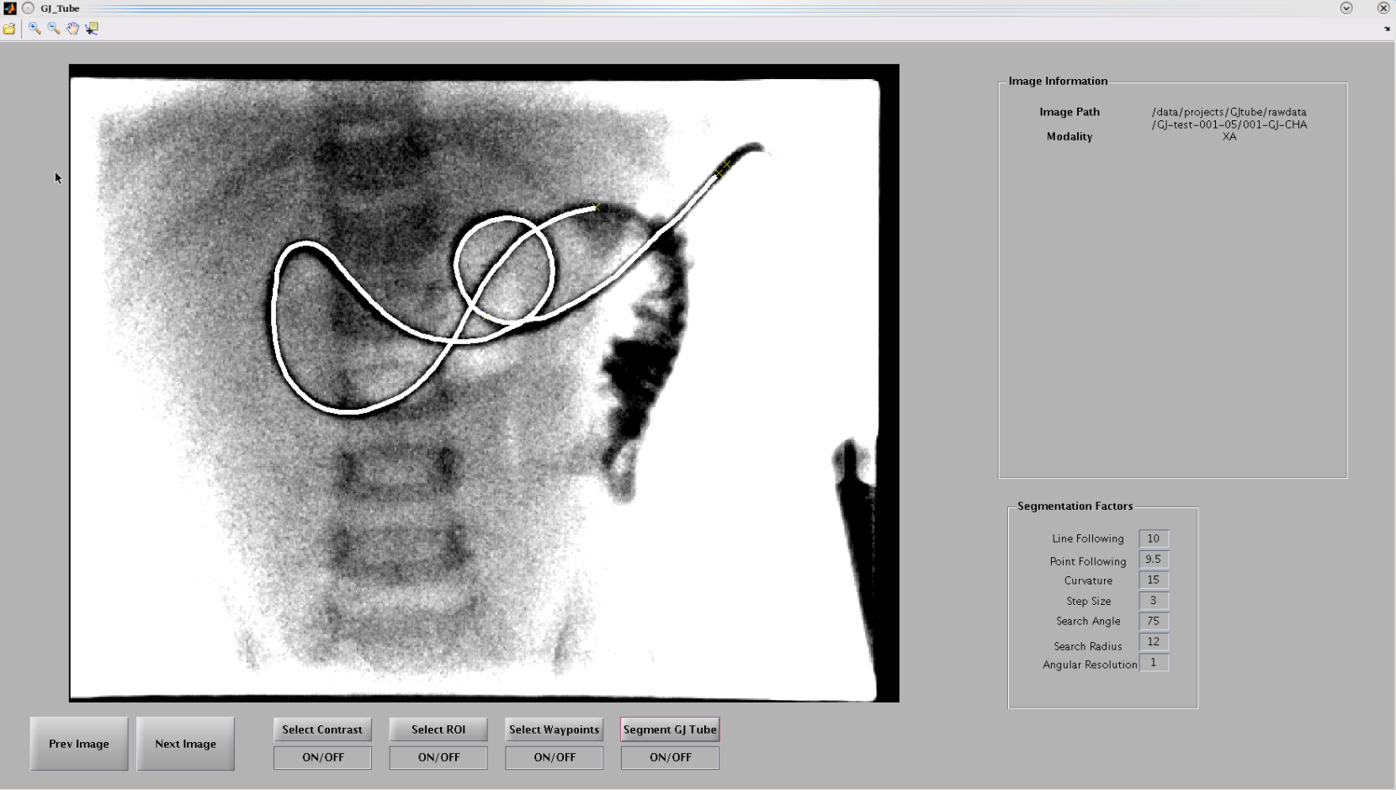
GJ Tube Segmentation
Segments out centre line
Uses algorithm that will be described

Slide 9
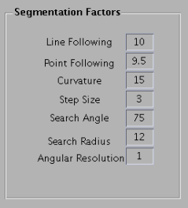
Segmentation Algorithm
Current algorithm is a stepper algorithm that starts at one point and then steps forward towards the end point
Depends on multiple constraints:
Step size
Search angle
Search radius
Angular Resolution

Slide 10
Segmentation Algorithm
The heart of the algorithm uses three methods to decide which direction to go
Line following
Point following (user given)
Curvature following
These are followed with different “strengths”

Slide 11
Room for Further Development
Goals for the UI:
More familiar contrast interface
Potentially (semi) auto contrasting
Time-slider
3D tube viewing (if angle is known)
Scale-bars/measurement tools

Slide 12
Room for Further Development
Goals for the Segmentation Algorithm
Less user inputs/greater accuracy
Maintain that user may help if it fails
3D tube segmentation (if angle is know)
Tube width measurements
Faster (if possible)

Slide 13
Questions
Is it possible to know the angle at which an x-ray was taken?
What would be the most useful information to display from the DICOM file?
What would be the most useful information to know about a segmented GJ Tube?
What contrasting interface would be the most intuitive/familiar for a doctor?

